Slide 1
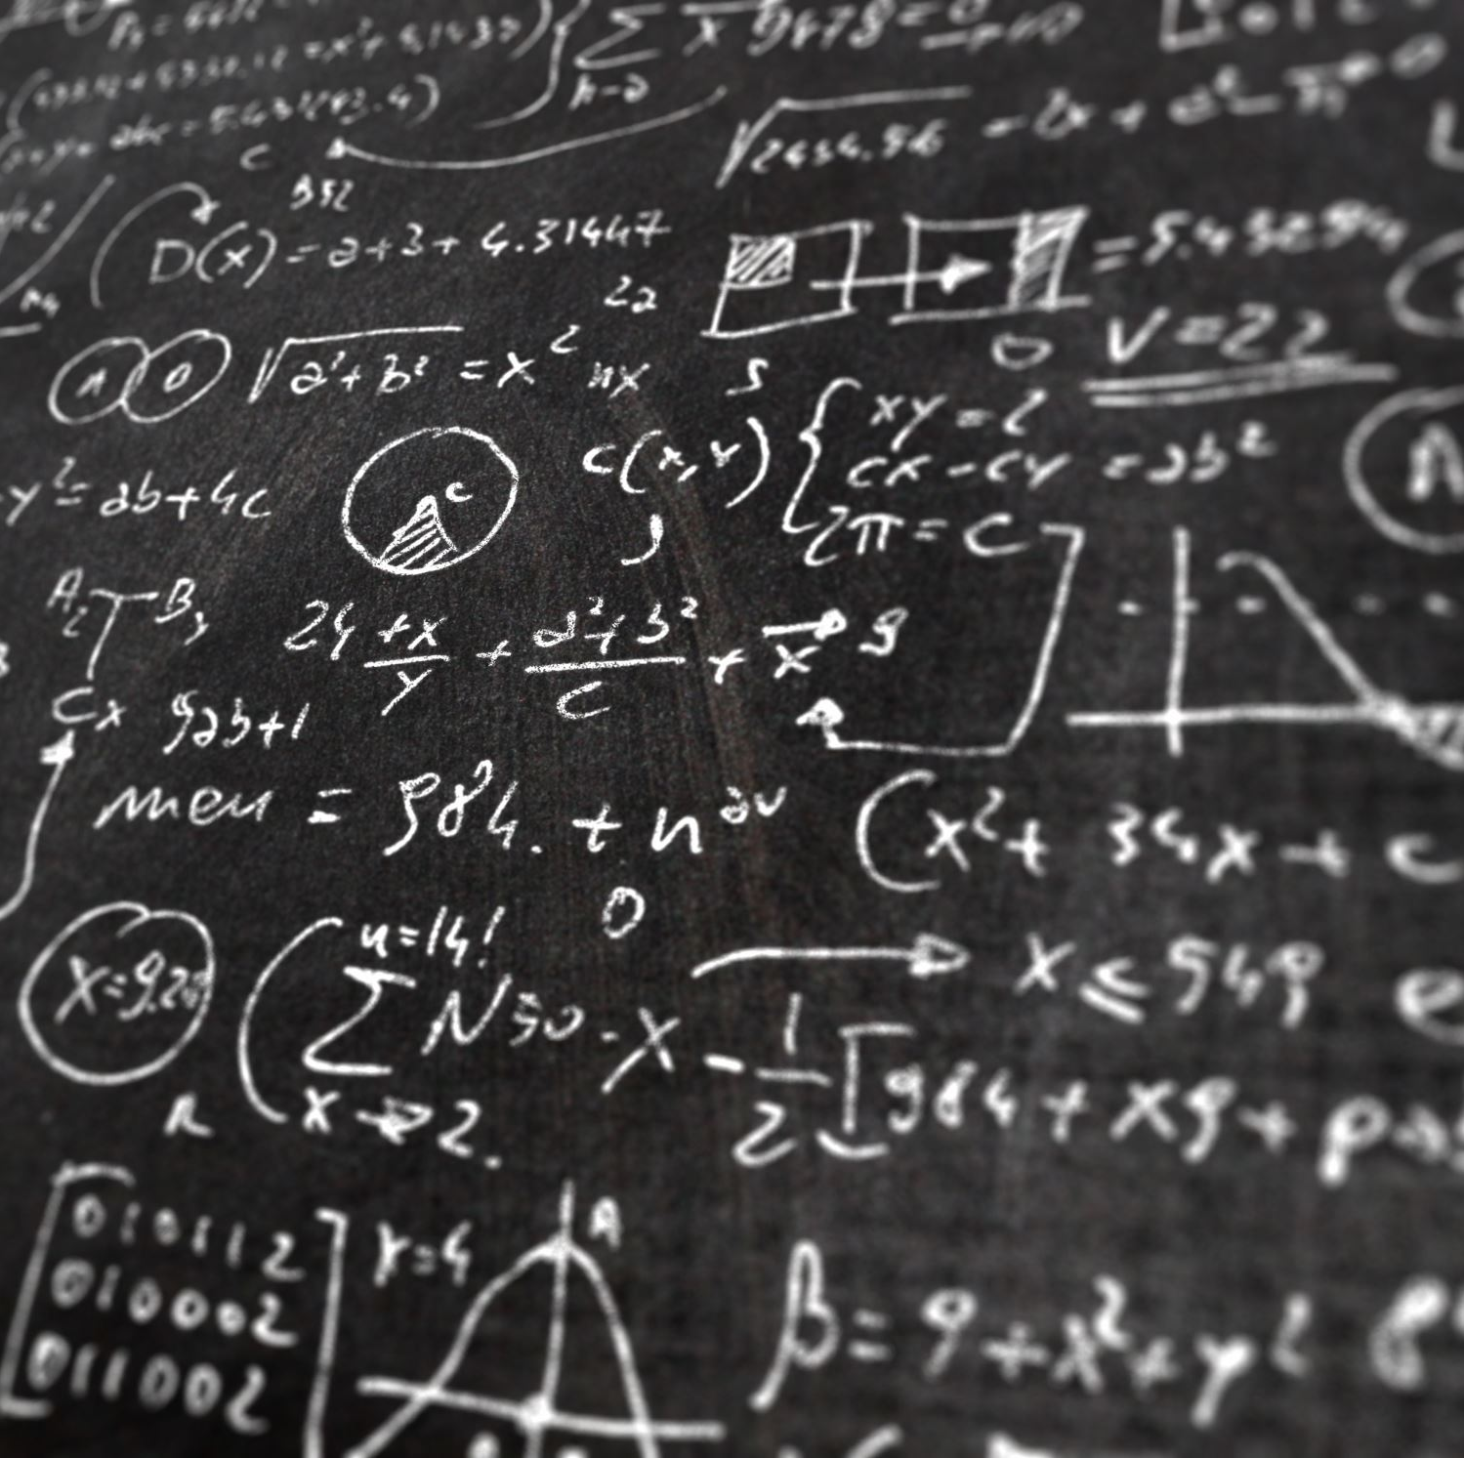
Project 2 – FINDING ALPHA
GrouP 6
SAIM ZUBERI

Slide 2
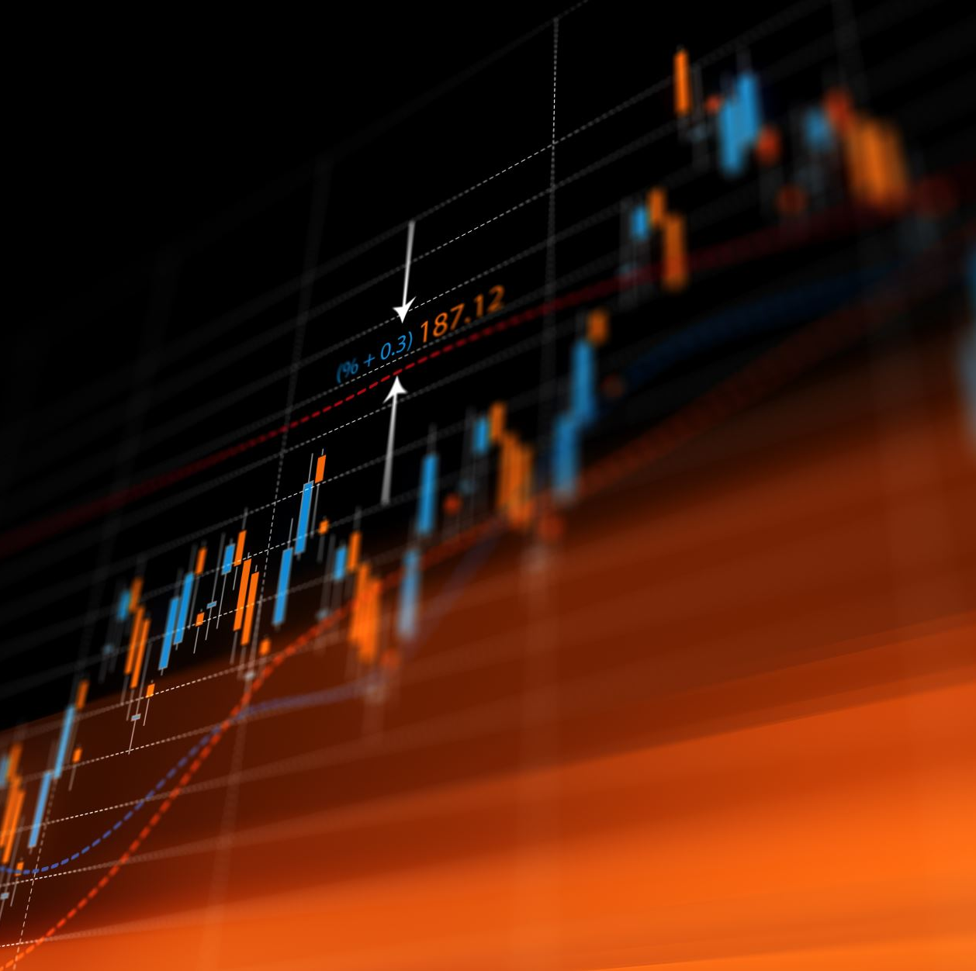
OBJECTIVES
Enhance the trading BOT created and enhance its functionality to a level where we can make minute based decision using algothrims and also use the same data set to predict the future vaules of the trade by prediicting price movements.

Slide 3

Challenge
Predicting an event 15 minutes before it happens is an ideal situation and in this project, I have tried to meet this challenge head on using Neural Networks.

Slide 4

Neural Network and AI exploration during Implementation
LSTM Model
Multimonial Logistic Regression
Random Forest Classifier
Prophet

Slide 5

LIBRARIES EXPLORED
LIBRARIES
TA-LIB
Polygon
Tqdm

Slide 6
KEY FEATURES
Leveraging Pologon.io for data for crypto market data on minute bars.
Using Algorithmic trading to do trades on minutes basis.
Using multiple parameter to define buy and sell signals.
Back tested module for Algorithmic Trade and defining P&L
Using over 1,000,000 datapoints to back test the algorithm

Slide 7
KEY INDICATOR LIST
df['ClosePct']=(df['close']-df['low'])/(df['high']-df['low'])
df['Range']=df['high']-df['low']
df['RangeMa']=df['Range'].rolling(30).mean()
df['RangeSD']=df['Range'].rolling(30).std()
df['RangeZscore']=(df['Range']-df['RangeMa'])/df['RangeSD']
df['SMA_Fast'] = df['close'].rolling(window=short_window).mean()/df['close']
df['SMA_Slow'] =df['close'].rolling(window=long_window).mean()/df['close']
df['RSI']=talib.RSI(df['close'], timeperiod=30)
df['Volume_PCT'] = df['volume'].pct_change()
df['SMA_Fast_'] = df['close'].rolling(window=short_window).mean()
df['SMA_Slow_'] = df['close'].rolling(window=long_window).mean()
df['SMA_Fast_pctchange']=df['SMA_Fast_'].pct_change()
df['SMA_Slow_pctchange']=df['SMA_Slow_'].pct_change()
df['rolling_mean'] = df['close'].rolling(short_window).mean()
df['rolling_std'] = df['close'].rolling(short_window).std()
df['Bollinger High'] = (df['rolling_mean'] + (df['rolling_std'] * 2))/df['close']
df['Bollinger Low'] = (df['rolling_mean'] - (df['rolling_std'] * 2))/df['close']
df['rolling_slope'] = df['close'].rolling(window=minutes_back).apply(get_slope, raw=False)

Slide 8
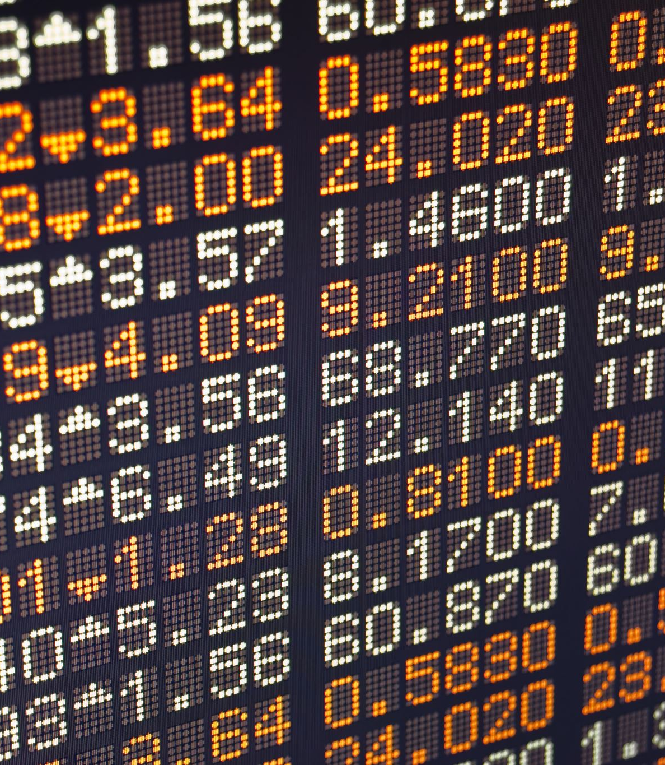
Indicators for Algo Trading System
For index, row in signals_df.iterrows():
if row["ClosePct"] < row["Bollinger Low"] and row["SMA_Fast"] > row["SMA_Slow"] and row["RSI"] < RSI_Buy :
signals_df.loc[index, "Signal"] = 1.0
if row["ClosePct"] > row["Bollinger High"] and row["SMA_Fast"] < row["SMA_Slow"] and row["RSI"] < RSI_Sell :
signals_df.loc[index,"Signal"] = -1.0
Note: Bollinger Low , Bollinger High , SMA_Fast and SMA_Slow all have been rationalized with closing price.

Slide 9
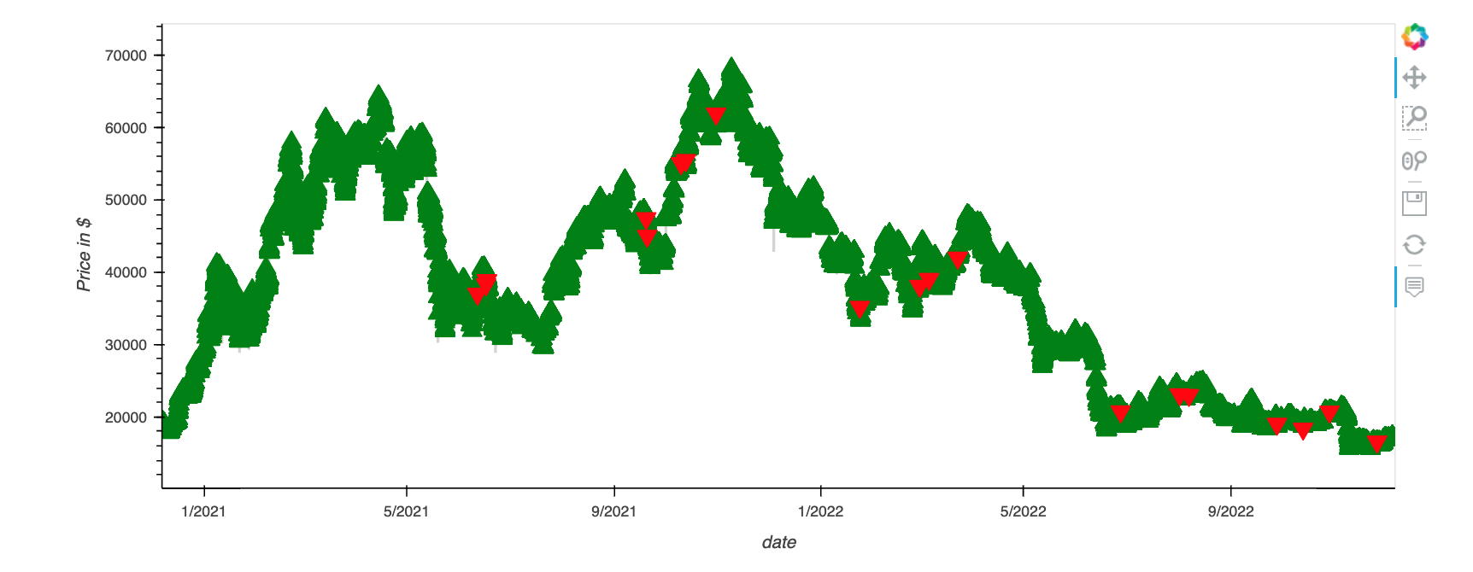
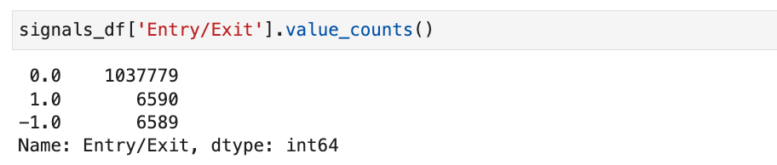
Resulting Trades Data

Slide 10
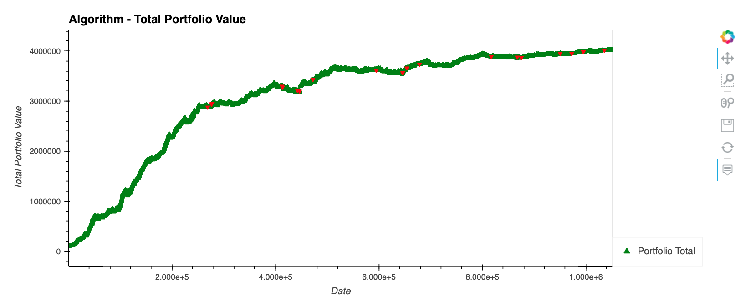
Backtesting Results
The Algo performed badly in the the upward markets but perform in a batter manner in the downward market.

Slide 11
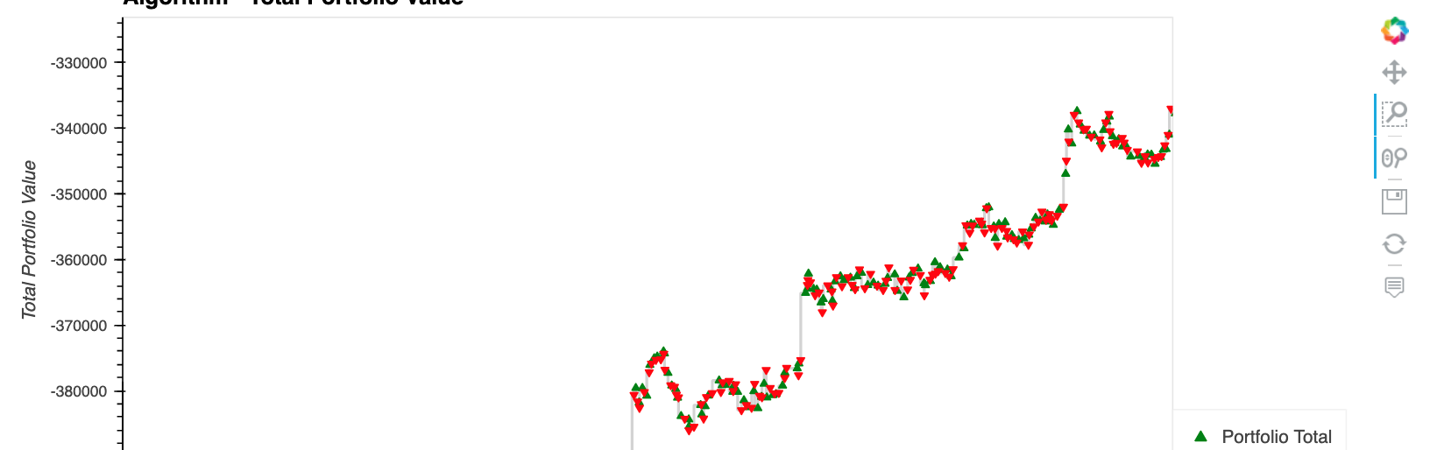
Trades View
The Flaw of the system is if we include the cost of transaction the losses will become more pronounced on the portfolio.
Also the number of sell signals are so few that the portfolio keeps on growing.

Slide 12
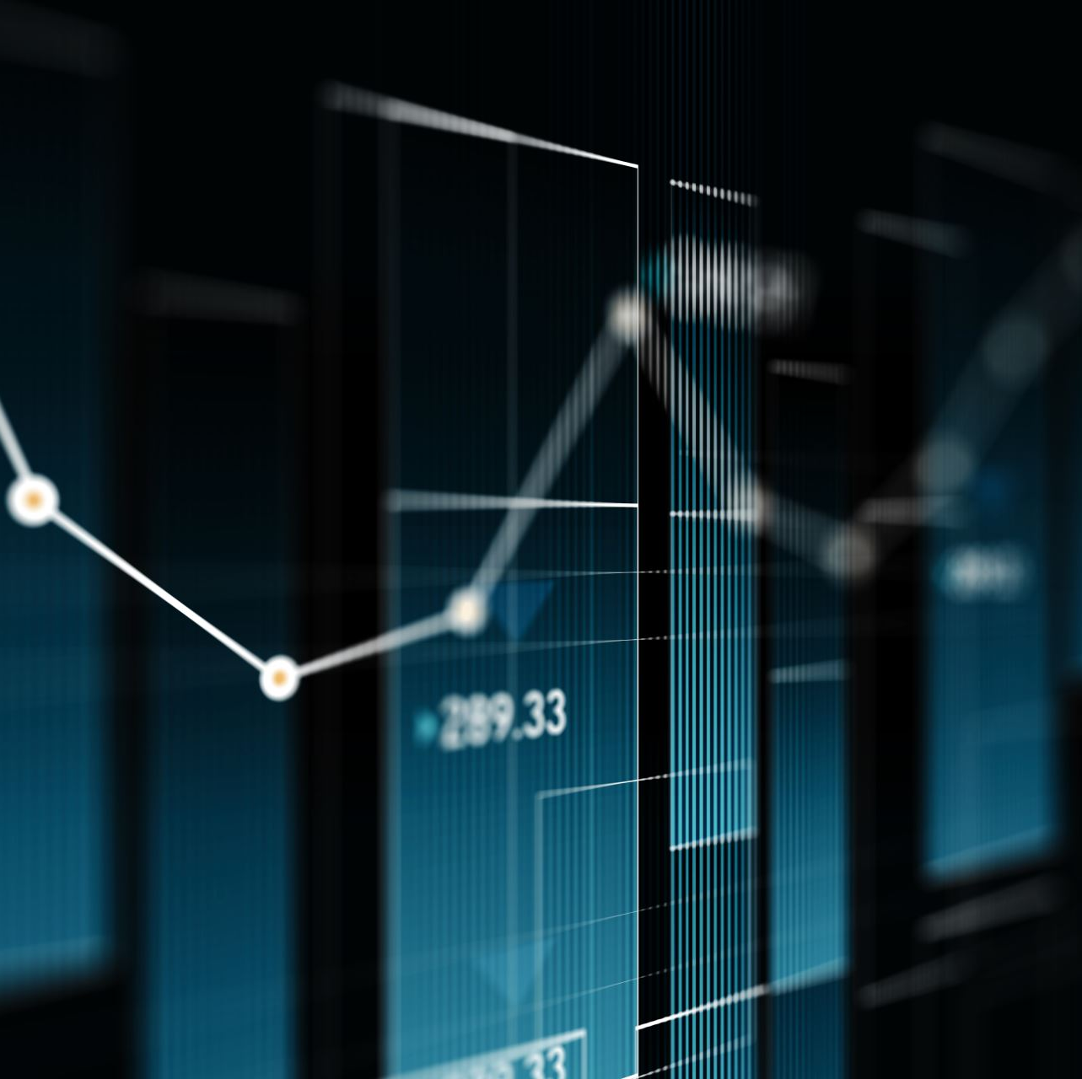
Optimization of Algo Model with Neural Network
In order to optimize the algo model, we shifted the percentage change with 15 bars and using the data set collected we ran a Neural Network Model to predict the percentage change using 13 features.

Slide 13

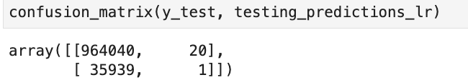
Predicting Buy Signal Results

Slide 14
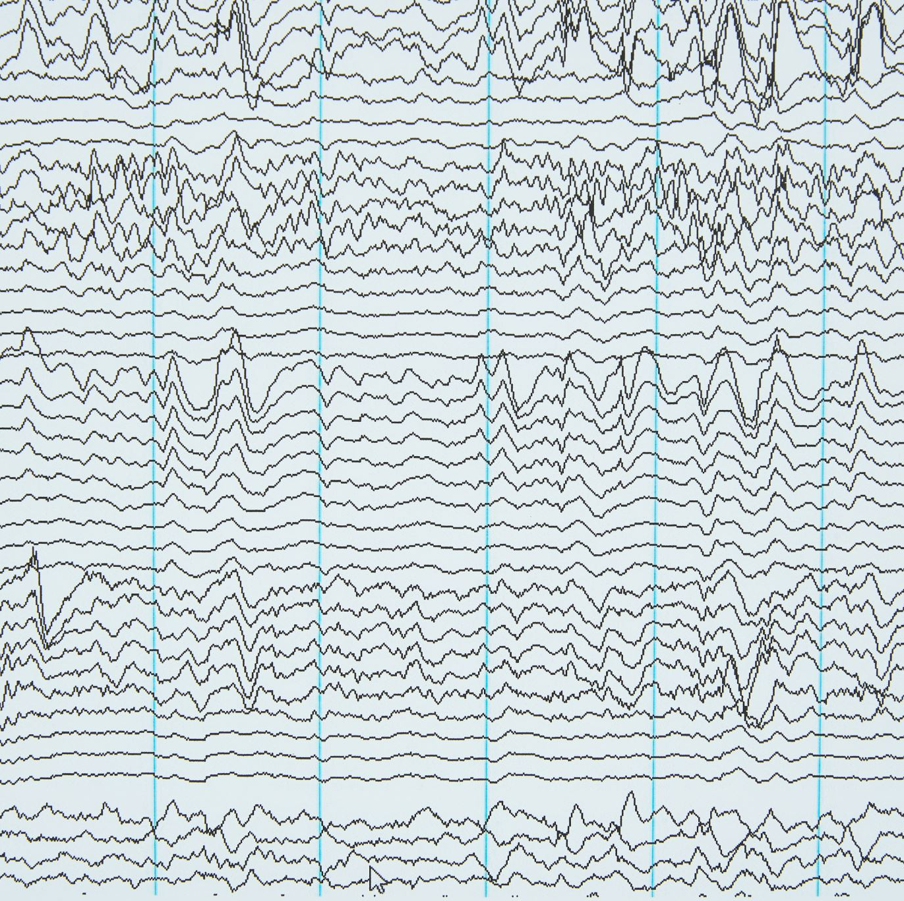
Model Features
Total Data Points – 5022351
Total Features – 13
Target – Percentage Change
Scaler – Minmax
Hidden Layer 1 – 8
Hidden Layer 2 – 4
Activation Function – Relu
Output activation - Linear
* Model is still compling

Slide 15
Future Roadmap
This has a lot of potential in try and testing and optimizing the model with various capabilities specifically capability of predicting future cross overs.
I want to build a front interface over the web where people can request a stock and I can provide them with trading my models returns based on these models.

Slide 16
CONCLUSION
Build triggers based on BEAR & BULL PATTERNS
Compare historical data with buy & hold strategy in relation to bot based strategy.
Implement risk portfolio selection based on monte carlos simulations since there is a strong corelation based on our analysis.

